Slide 1

Marketing Web Analytics and Insights
GROUP 10

Slide 2

01
COMPANY OVERVIEW
WALMART

Slide 3

OVERVIEW
Walmart is a global retail giant renowned for its vast network of stores, offering a diverse range of products from groceries and apparel to electronics.
Founded in 1962 by Sam Walton, it has grown into one of the world's largest corporations, serving millions of customers daily through its commitment to low prices and diverse shopping experiences.
With a strong emphasis on innovation and community impact, Walmart continues to shape the retail landscape globally.

Slide 4
OVERVIEW
VISION
MISSION
OBJECTIVES
To be the best retailer in the hearts and minds of consumers and employees
To save people money so that they can live better
To offer affordable goods while promoting convenience and sustainability worldwide.

Slide 5

BUSINESS OBJECTIVES
CUSTOMER SATISFACTION
GLOBAL MARKET LEADERSHIP
OPERATIONAL EFFICIENCY
Affordable, diverse products; enhanced shopping experiences
Expansion, dominance in retail, online markets
Streamlined logistics, cost reduction, improved productivity

Slide 6
KEY PERFORMANCE INDICATORS
Average Order Value (AOV)
Average Session Duration
Bounce rate
Conversion Rate
Unique visitors
Market reach
Page Load Time
Server response time
Revenue
CUSTOMER EXPERIENCE
ONLINE MARKET SHARE
OPERATIONAL EFFICIENCY

Slide 7
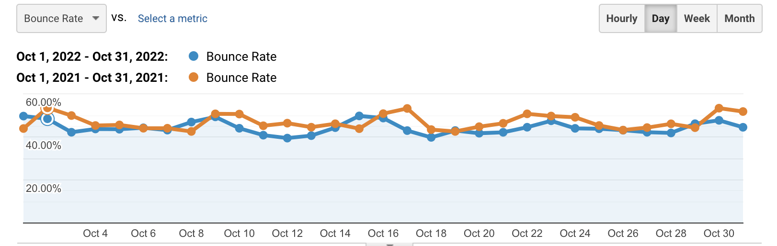
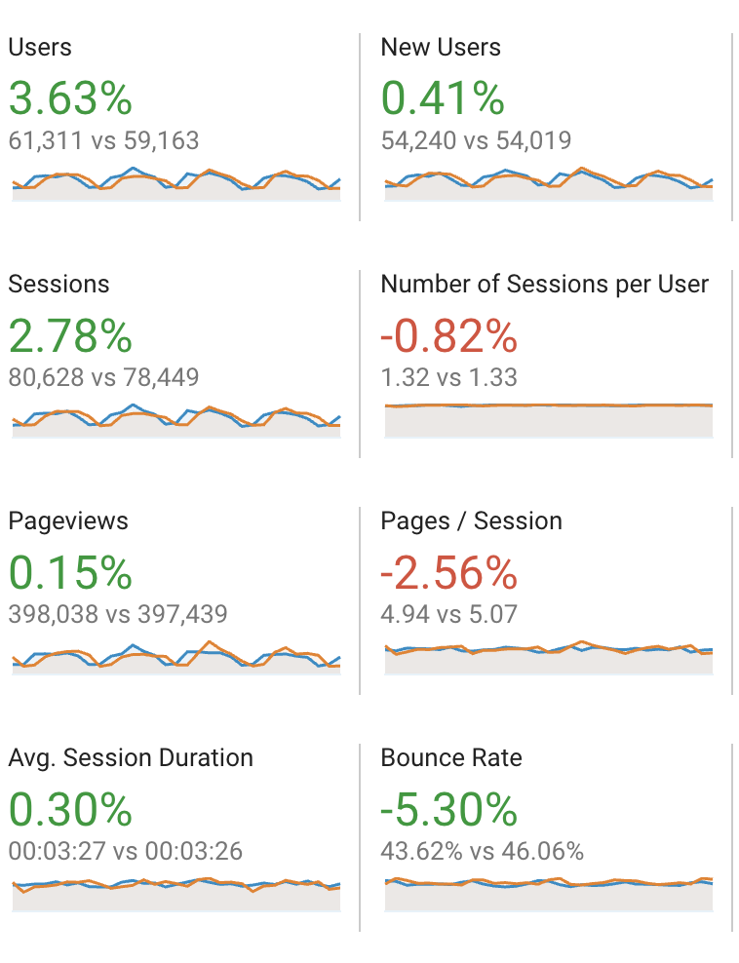
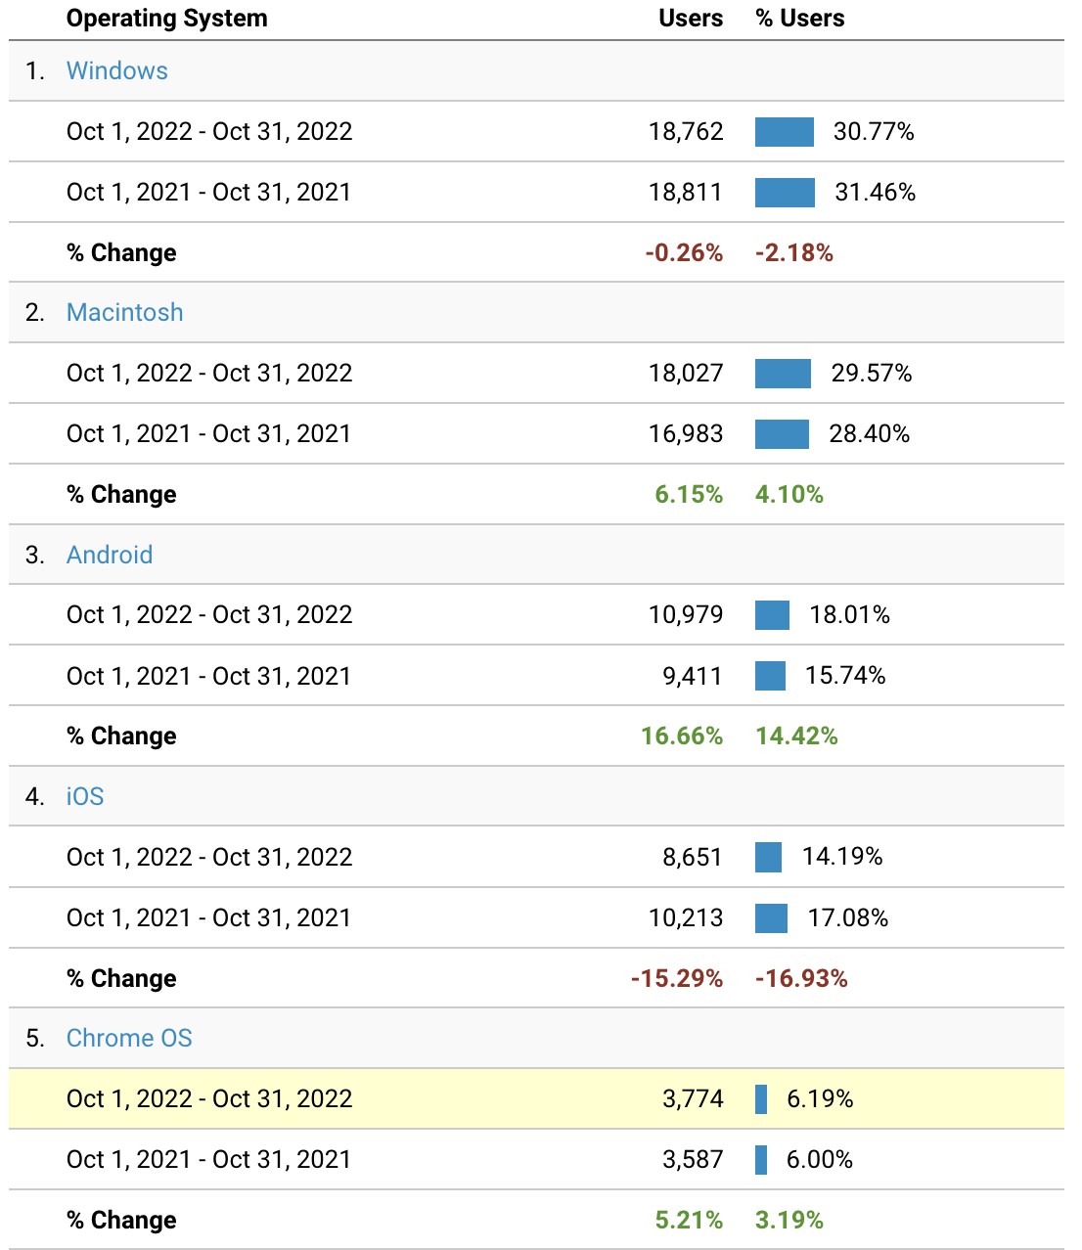
BOUNCE RATE (%)
Observation: The overall bounce rate on the site dropped by 5.30%. When we looked at bounce rates based on the customers' operating systems, we noticed a big drop for IOS users (16.93%) but an increase for Android users (14.42%). This suggests we might need to focus on improving the experience for Android users.

Slide 8
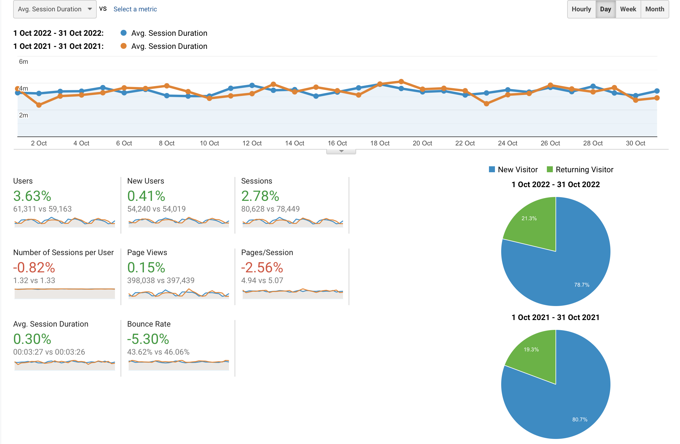
AVERAGE SESSION DURATION
Observation: There has been an extremely small change in the average session duration of 0.30%. We need to improve the user interface of our website and market best-selling products better to make sure the number of sessions per user increases. There has been an improvement in the number of returning users from 19.3% to 21.3%. We can also focus on retaining existing customers by providing membership benefits.

Slide 9
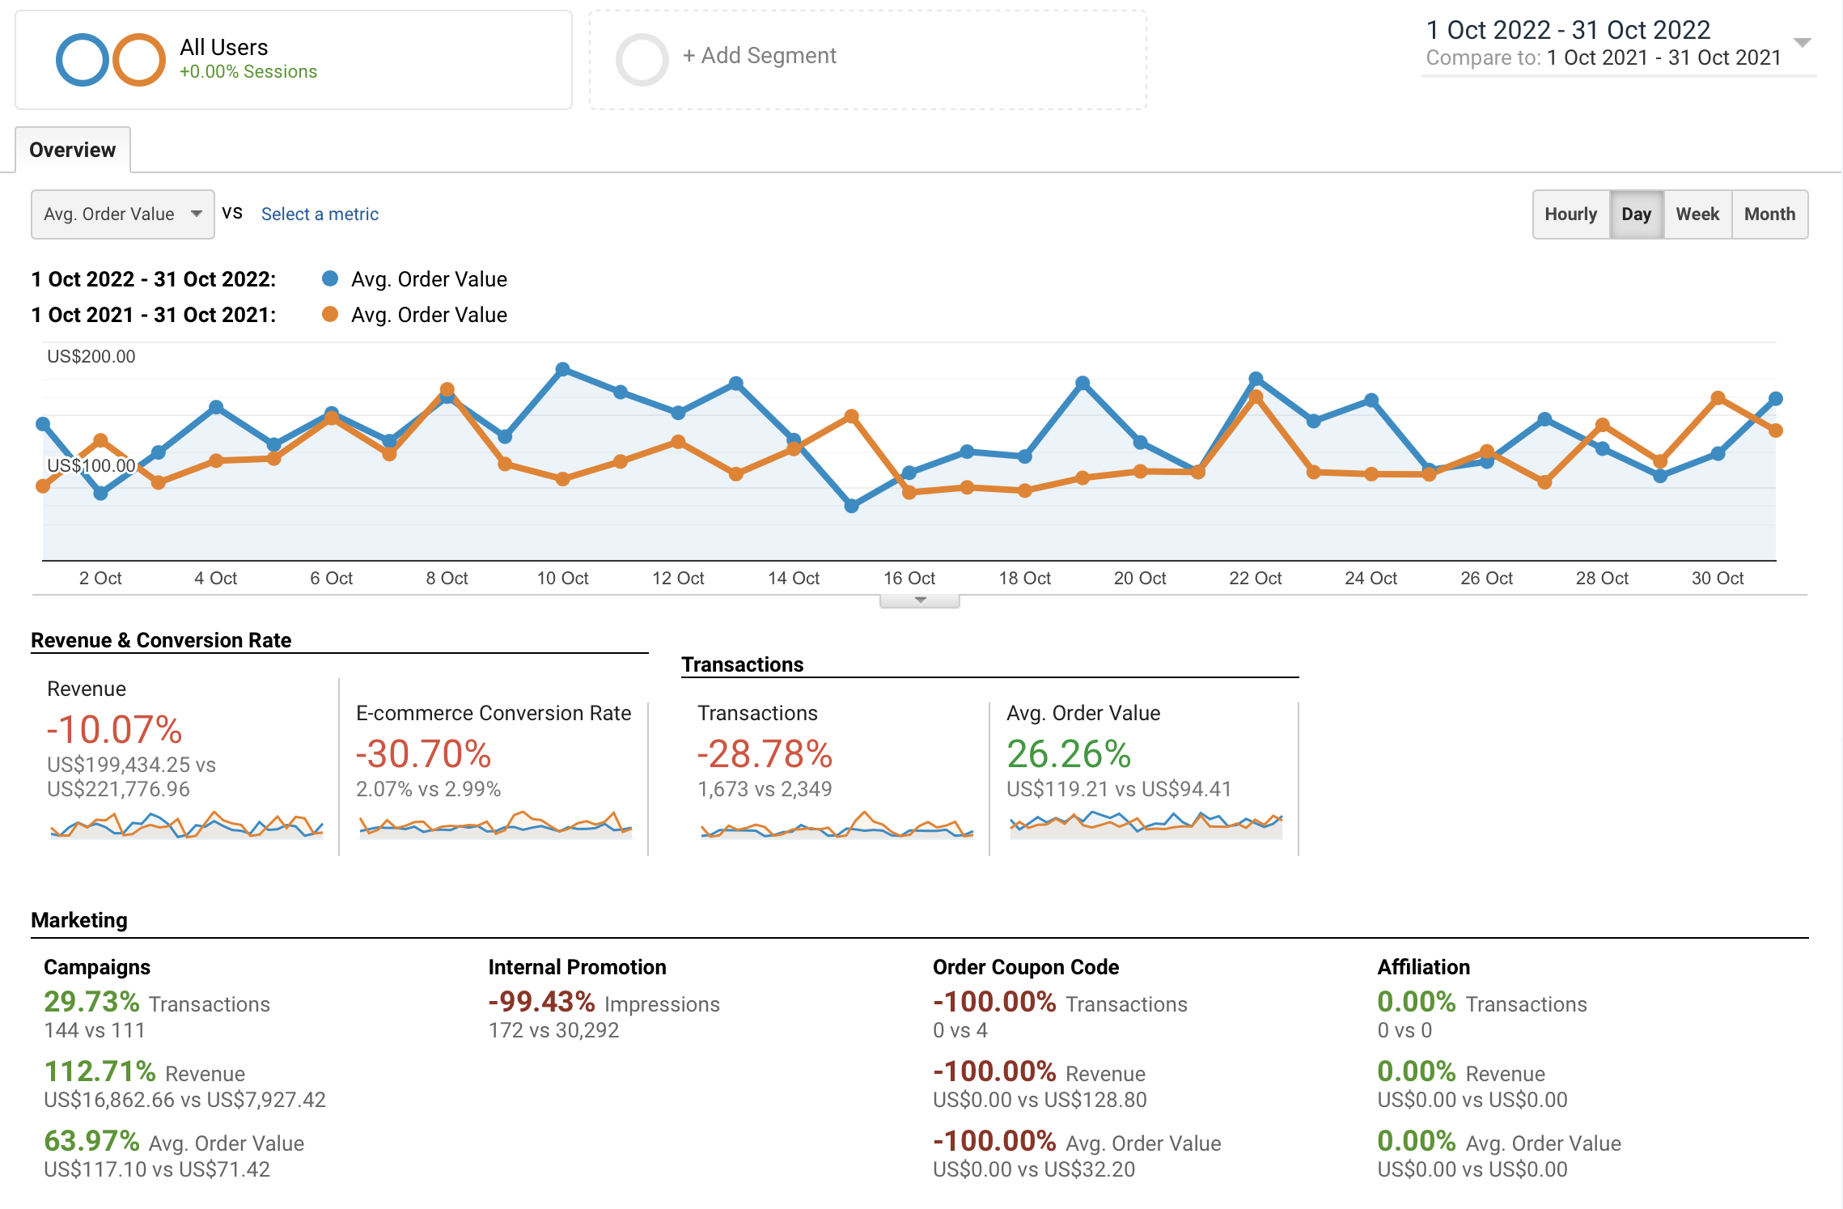
AVERAGE ORDER VALUE (AOV)
Observation: The average order value has increased by 26.26%. It was US$94.41 in October 2021 and has increased to US$119.21 in October 2022. We are doing well in terms of marketing through campaigns with 63.97% increase in AOV but need to enhance our internal promotions and provide more appealing coupon code offers to persuade customers to shop more which will in turn lead to growth in AOV.

Slide 10
RECOMMENDATIONS
Android User Experience: Improve interface for Android users to reduce bounce rates. Conduct usability tests, analyze user feedback, and streamline the interface to cater better to Android devices.
Enhance IOS Marketing: Analyze what aspects led to this improvement and use these insights to refine marketing strategies
Optimize UI & Product Highlights: Increase session duration by refining website layout and product visibility. Highlight best-selling products, improve navigation, and optimize the layout to encourage users to explore more, thereby increasing the number of sessions per user.
Membership Benefits: Loyalty programs, exclusive offers, and personalized recommendations could be employed to strengthen customer retention strategies.
Boost AOV with Coupons: Offer appealing coupon codes or exclusive discounts to encourage customers to spend more per transaction.

Slide 11
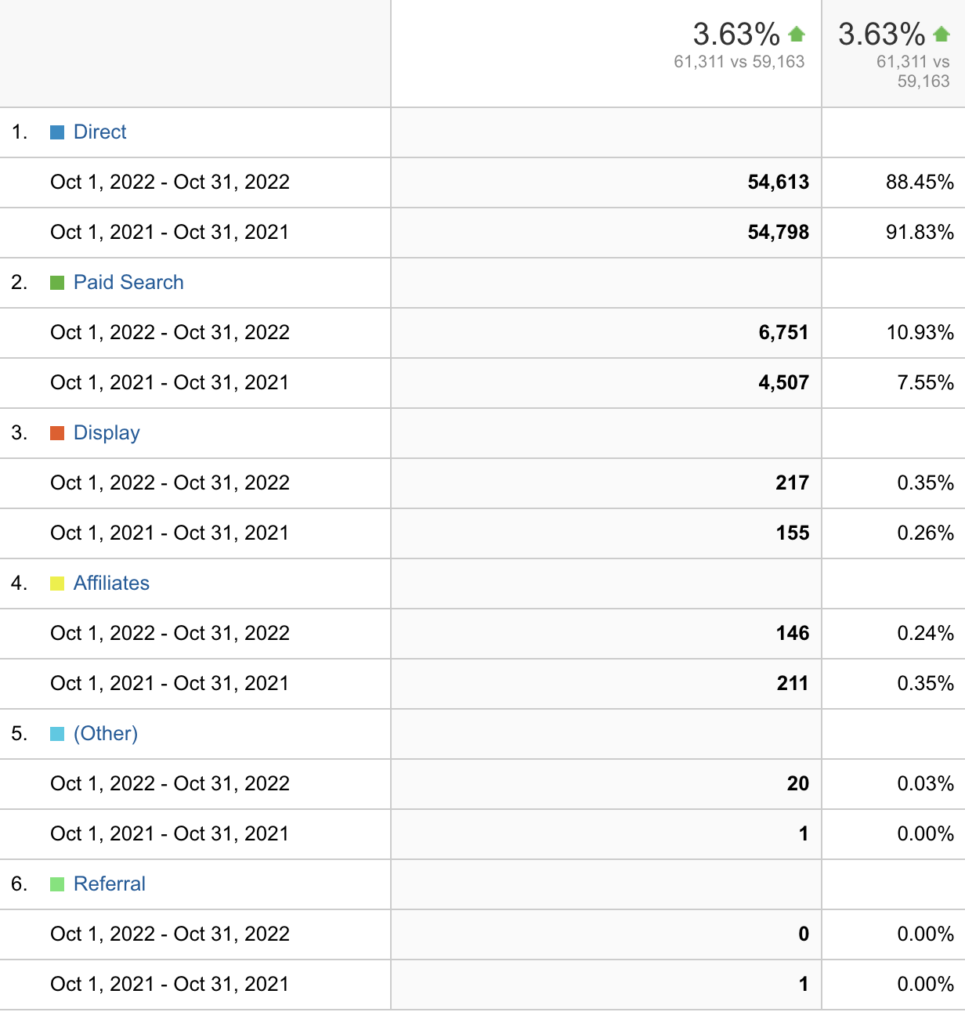
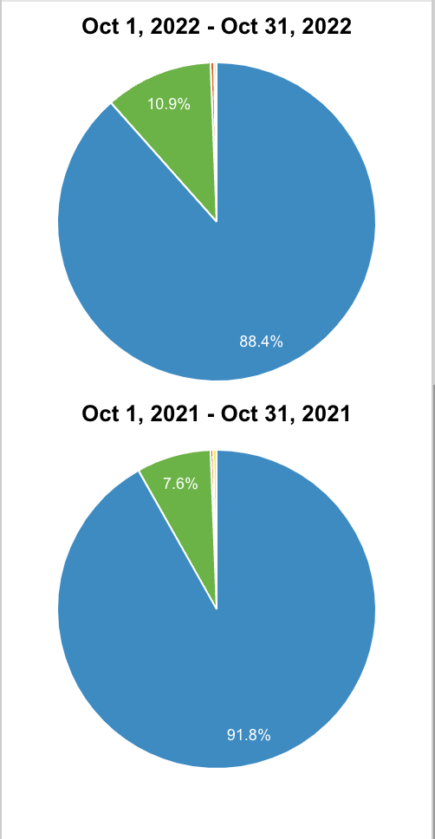
CONVERSION RATE
Observation: The overall conversion rate rose by 3.63% in a year, with Direct Users' rate declining but Paid Search seeing a significant increase. Walmart should investigate Direct Users' experience to boost their conversion rates and capitalize on strategies driving the surge in Paid Search for sustained growth.

Slide 12
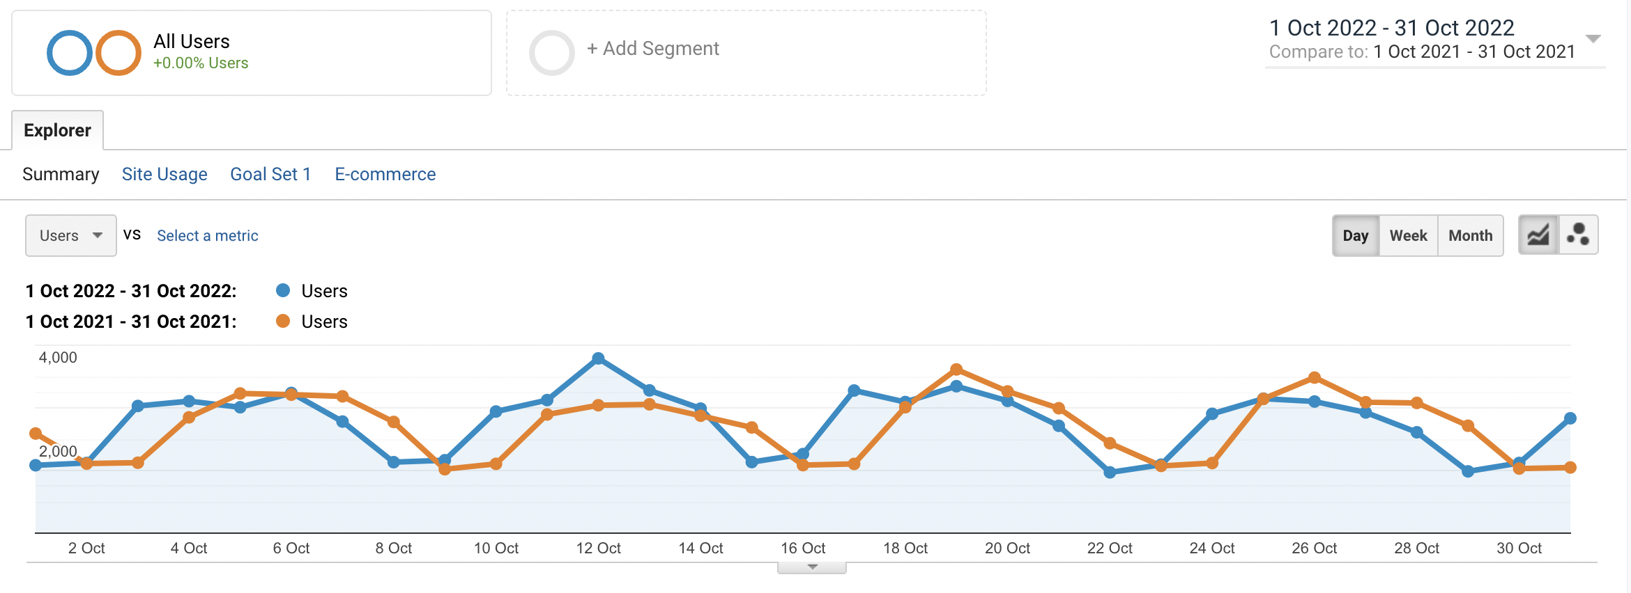
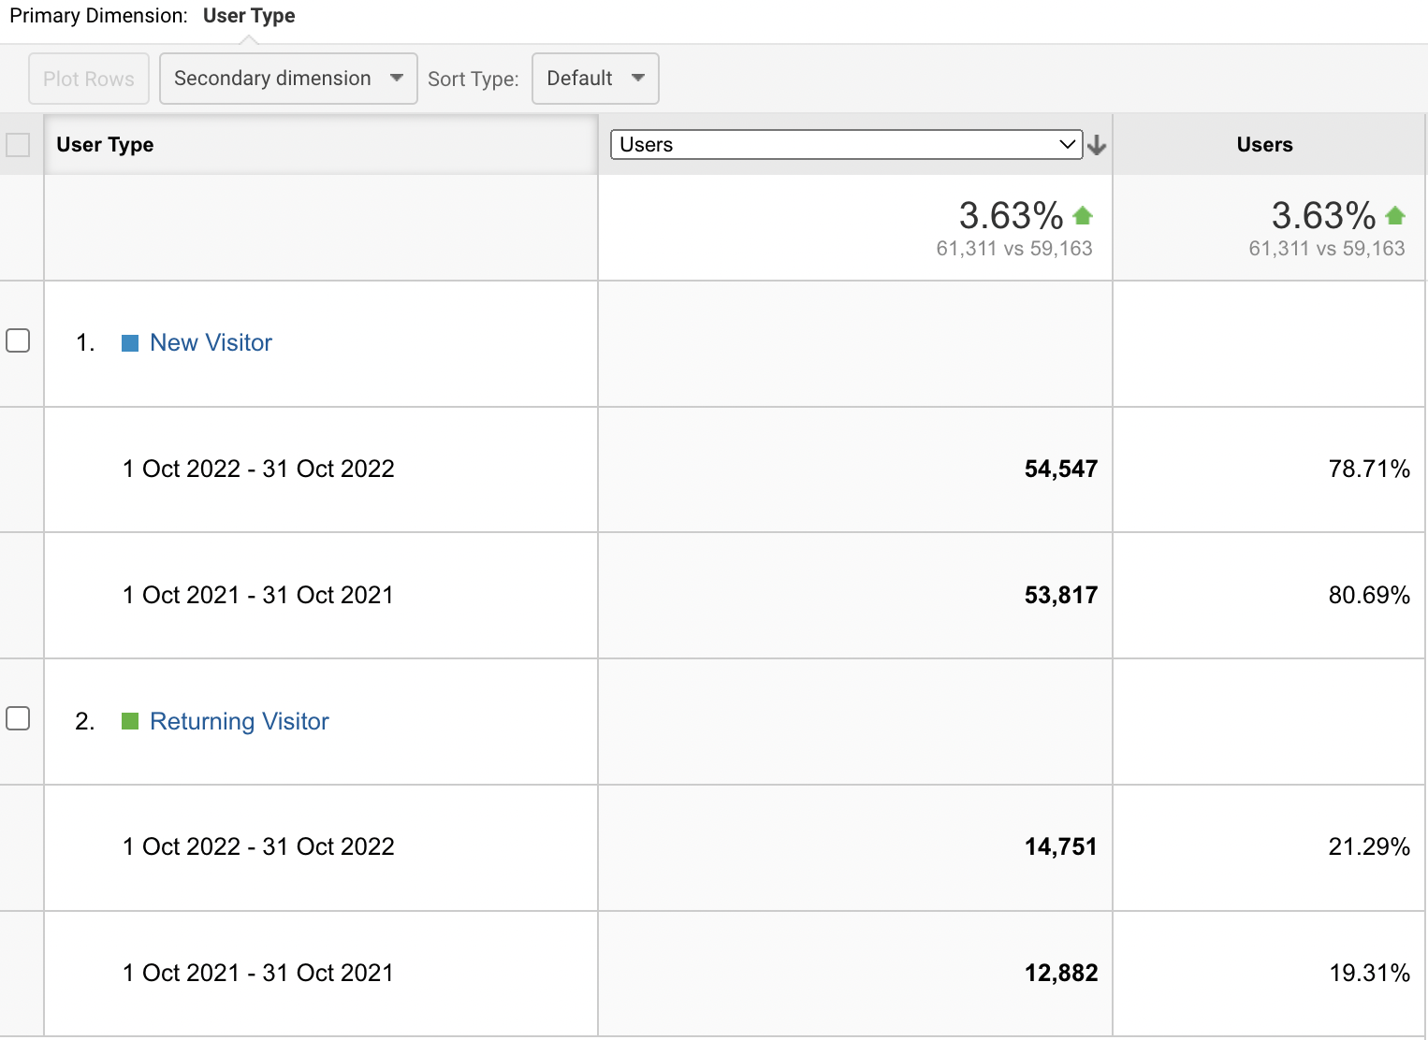
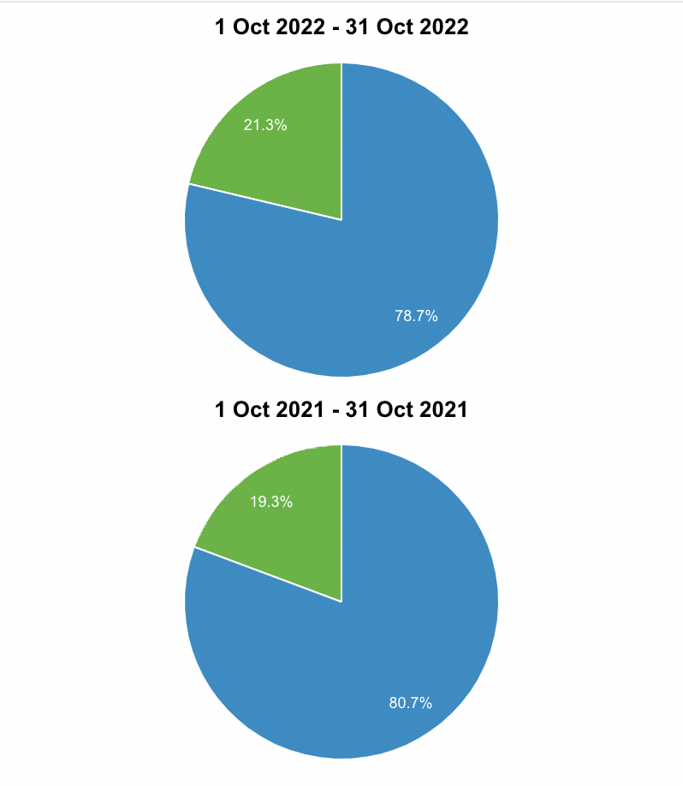
UNIQUE VISITORS
Observation: In comparing the data from October 2021 to October 2022, there is a noteworthy 3.63% increase in the overall number of visitors, encompassing both new and returning users. Specifically, in October 2022, the count of new visitors reached 54,547, representing a modest rise from the 53,817 new visitors recorded in October 2021. This indicates a slight but discernible growth in the number of unique visitors over the preceding year.

Slide 13
MARKET REACH
Observation:

Slide 14
RECOMMENDATIONS

Slide 15
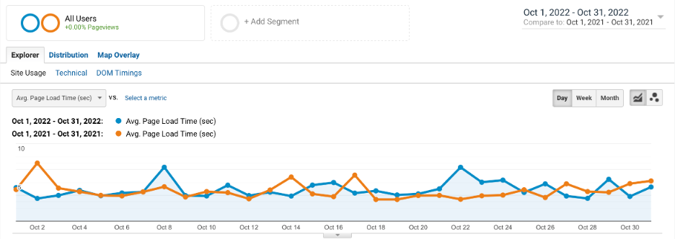
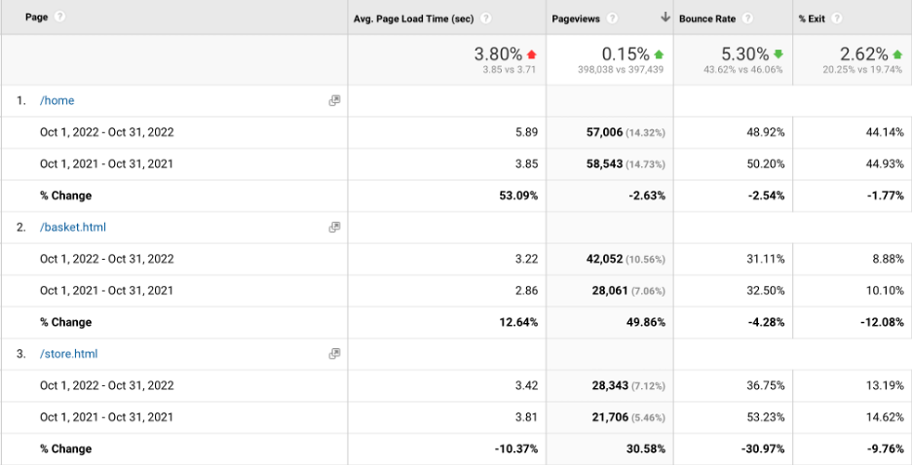
PAGE LOAD TIME
Observation:
Walmart Experienced a 2-second rise in Average Page Load Time between Oct 2021 and Oct 2022, resulting in a reduction of 1000 pageviews. However, during this period, the Bounce Rate decreased from 50.20% to 48.92%.

Slide 16
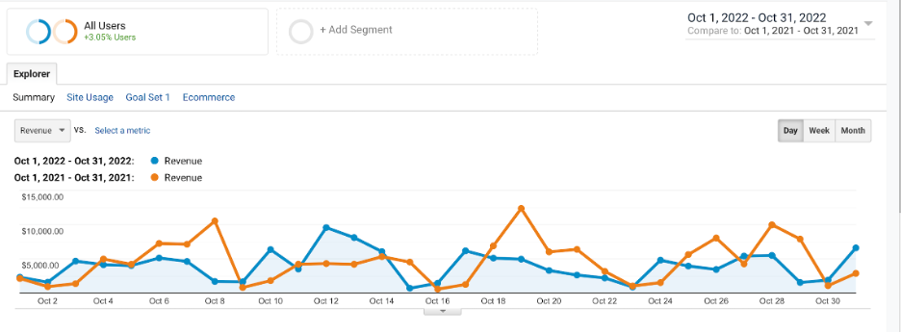
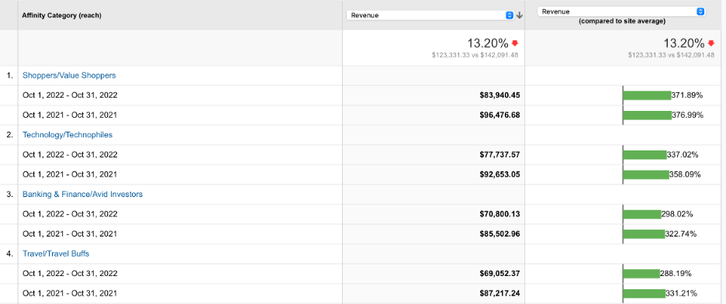
REVENUE
Observation:
Walmart experienced a 13.20% decline in revenue from Oct 2021 to Oct 2022, with the technology section being notably impacted as the most affected sales area with a difference in sales of almost $15,000.

Slide 17
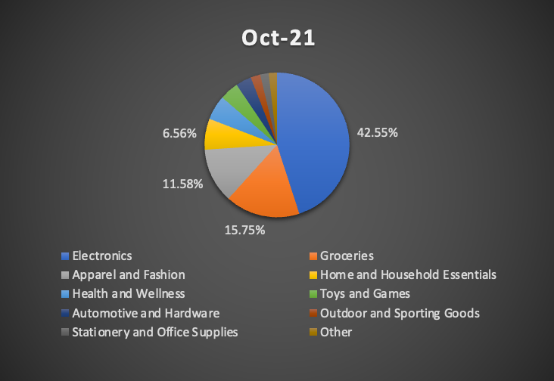
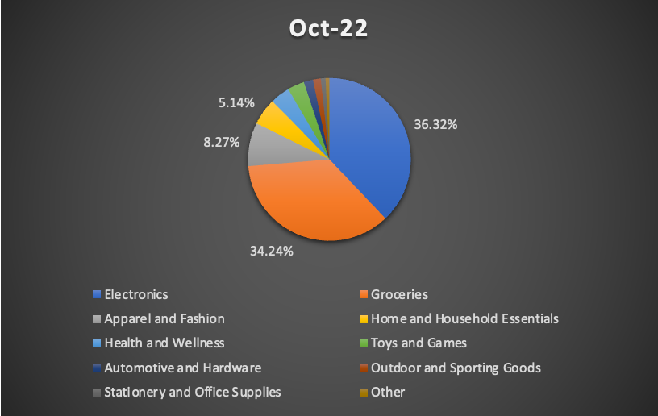
REVENUE BY PRODUCT CATEGORY
Observation: Walmart has over 10 Product Categories out of which 4 Categories (Electronics, Groceries, Clothing and Household Essentials) contribute to nearly 80% of the revenue. We can tailor emails

Slide 18
RECOMMENDATIONS

Slide 19
THANK YOU!

Slide 20
ALTERNATIVE RESOURCES

Slide 21
ALTERNATIVE RESOURCES

